Slide 1

Ontology-Driven Software Development: Generating Java Code from OntoUML
Faculty of Electrical Engineering, Mathematics and Computer Science
Guus GRIEVINK, LuÍs FERREIRA PIRES, João Luiz REBELO MOREIRA, Arend RENSINK
Semantics, cybersecurity and services (SCS) group

Slide 2
Model-Driven Software Engineering (MDE)
Research approach
MDE Transformation pipeline
Validation
Conclusions
Notes:
1. Model-Drive Software Engineering
OntoUML
Ontology-Driven Software
2. Research approach
3. Transformation pipeline
Ecore metamodel
OntoUML JSON reader
OntoUML to UML mappings
Transformations 1: OntoUML to UML
Transformations 2: Java code generation
4. Validation
5. Conclusion

Slide 3
Model-Driven Software Engineering (MDE)
Research approach
MDE Transformation pipeline
Validation
Conclusions
Notes:
1. Model-Drive Software Engineering
OntoUML
Ontology-Driven Software
2. Research approach
3. Transformation pipeline
Ecore metamodel
OntoUML JSON reader
OntoUML to UML mappings
Transformations 1: OntoUML to UML
Transformations 2: Java code generation
4. Validation
5. Conclusion

Slide 4
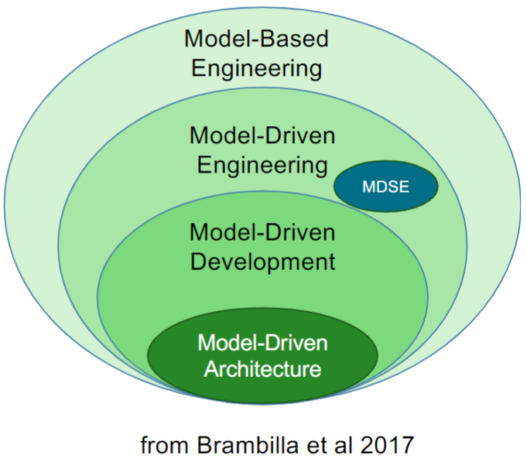
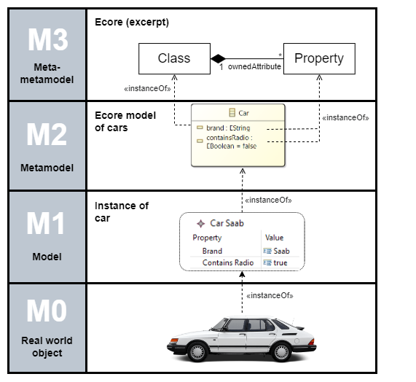

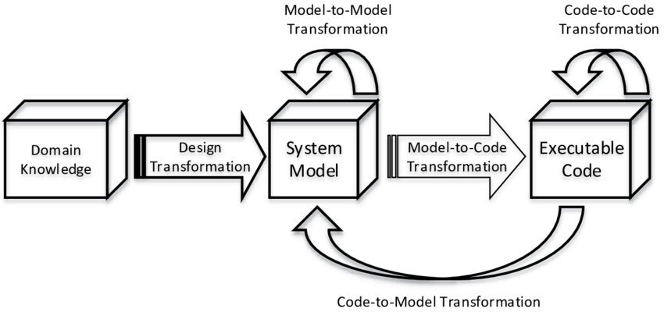

Model-driven software engineering
From domain models to software code!
Notes:
Rouhi, Alireza. (2017). Presenting a process for generating a pattern language verifier. 10.13140/RG.2.2.16991.97446.
Automated coding
Less error-prone
Simplifies maintenance and updates by making it easier to modify and extend software without rewriting large portions of code. It also enhances code quality by reducing human error and enforcing coding standards.

Slide 5

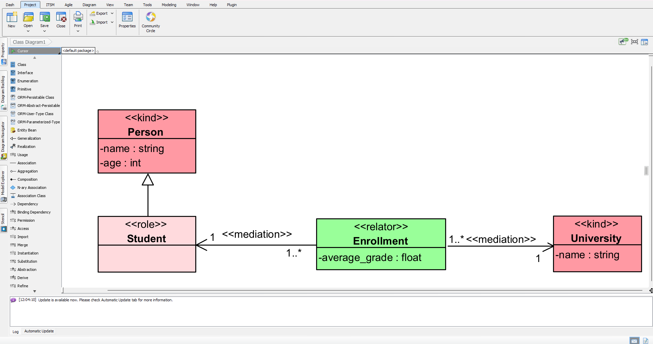
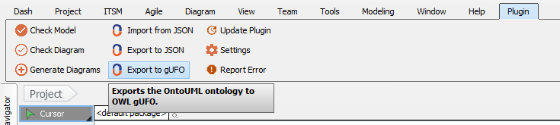

ontouml
Unified Foundational Ontology (UFO)
Top-level ontology: collection of ontological theories
Main concepts : Identity providers, Universal vs. Individual, Endurant vs. Perdurant, Sortal vs. non-sortal, Rigid vs. anti-rigids
https://github.com/OntoUML
OntoUML
Ontological Language (some UFO)
Tooling support (“2.0”)
Visual Paradigm Plugin ➔
Platform-independent metamodel
JSON Schema
OntoUML model catalogue
https://github.com/OntoUML/ontouml-models
Notes:
Unified Foundational Ontology (UFO): top-level ontology as a collection of ontological theories
Represents the most common concepts for classification
Identity providers
Universal vs. individual
Endurant vs. perdurant
Sortal vs. non-sortal
Rigid vs. anti-rigids
OntoUML: ontological language that covers part of UFO
“OntoUML 2.0” tooling support include:
Visual Paradigm Plugin
Platform-independent metamodel
JSON Schema
OntoUML model catalogue
https://github.com/OntoUML

Slide 6
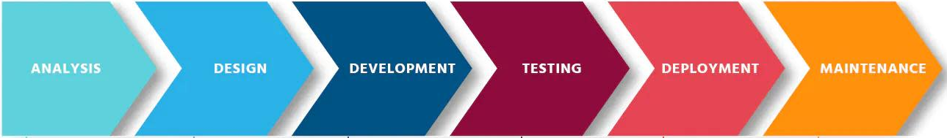

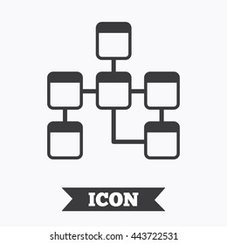




Ontology-driven software
Ontology-Driven Software Engineering (SE) uses ontology(ies) for each phase in SE
Knowledge-intensive software!
Problem
OntoUML is continuously evolving: tooling support getting deprecated
Conceptual models in OntoUML usually have higher quality than traditional UML
Software developers may not know OntoUML semantics
Creating an ontology can be time consuming (investment)
How to preserve OntoUML semantics in software code?
Notes:
Problem
Conceptual models made with OntoUML are of higher quality compared to traditional UML
Software developers may not know OntoUML semantics
Creating an ontology can be an investment
How to preserve OntoUML semantics in software code?
Ontology Driven Software Engineering (SE) uses ontology for each stage in SE., e.g., requirement, design and implementation phases.
Knowledge-intensive software!
A. J. Wiebe and C. W. Chan, "Ontology driven software engineering," 2012 25th IEEE Canadian Conference on Electrical and Computer Engineering (CCECE), Montreal, QC, Canada, 2012, pp. 1-4, doi: 10.1109/CCECE.2012.6334938. keywords: {Ontologies;Software;OWL;Software engineering;Semantics;Unified modeling language;Ontology;Software Engineering;Web Ontology Language (OWL)},

Slide 7
Model-Driven Software Engineering (MDE)
Research approach
MDE Transformation pipeline
Validation
Conclusions
Notes:
1. Model-Drive Software Engineering
OntoUML
Ontology-Driven Software
2. Research approach
3. Transformation pipeline
Ecore metamodel
OntoUML JSON reader
OntoUML to UML mappings
Transformations 1: OntoUML to UML
Transformations 2: Java code generation
4. Validation
5. Conclusion

Slide 8
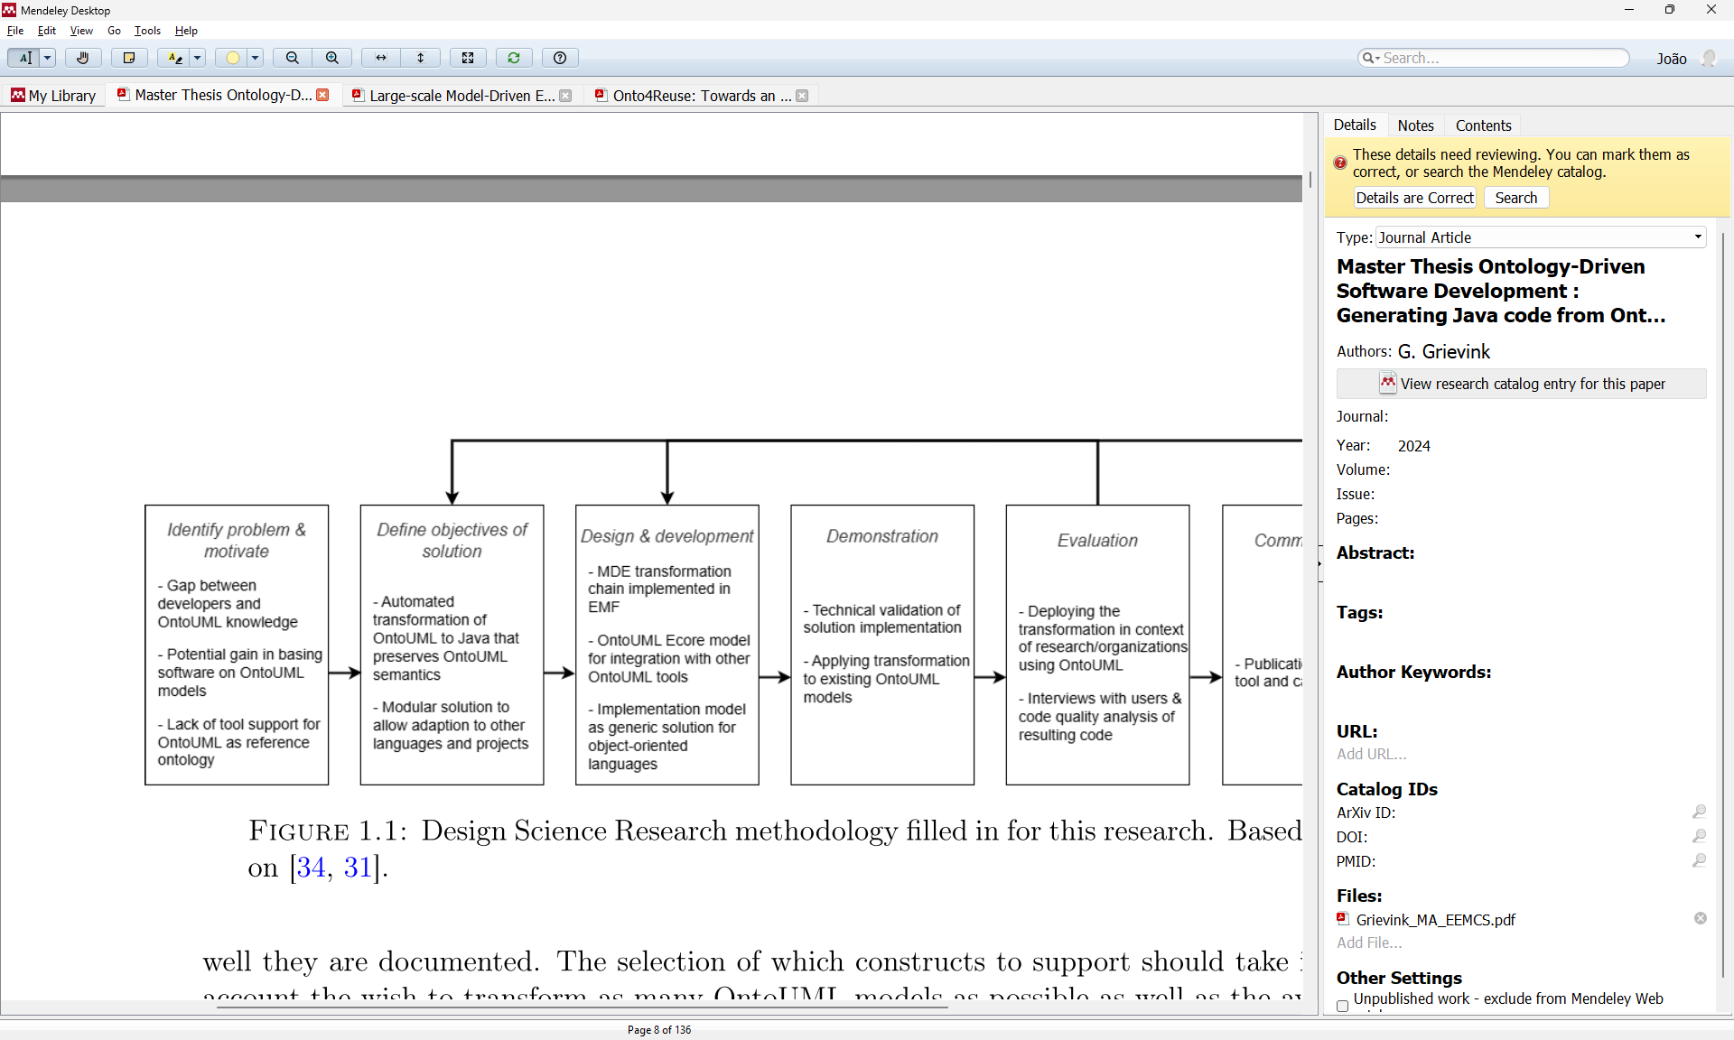
Research approach
Design Science Research Methodology
Problem: literature review, analysis of existing transformations (experiments)
Treatment design: automated transformation pipeline with EMF, considering OntoUML tools, for Java but keep in mind other OO languages
Treatment validation: transformation example, 82 OntoUML models (catalogue), manual validation
Notes:
Design Science Research Methodology
Problem investigation
Literature review
Analysis of existing transformations (experiments)
Treatment design
Automated OntoUML-to-Java transformation which preserves semantics
Compatible with existing OntoUML tools
Implement using EMF
First focus on Java, but also keep in mind generation of other programming languages
Treatment validation
Full transformation example
Transformation of OntoUML models from the catalogue
Manual validation

Slide 9
Model-Driven Software Engineering (MDE)
Research approach
MDE Transformation pipeline
Validation
Conclusions
Notes:
1. Model-Drive Software Engineering
OntoUML
Ontology-Driven Software
2. Research approach
3. Transformation pipeline
Ecore metamodel
OntoUML JSON reader
OntoUML to UML mappings
Transformations 1: OntoUML to UML
Transformations 2: Java code generation
4. Validation
5. Conclusion

Slide 10
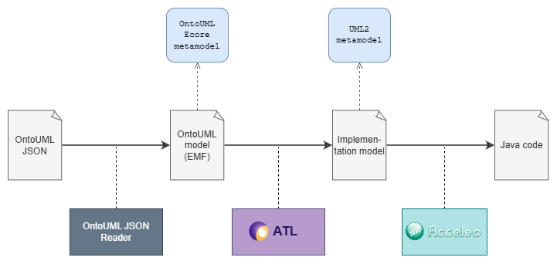
Transformations overview
1. OntoUML JSON reader from VP plugin
2. OntoUML Ecore metamodel
3. OntoUML ➔ UML
Conceptual mappings
ATL transformations
4. Java code generation (Acceleo)
Notes:
OntoUML JSON reader: from VP plugin
OntoUML Ecore metamodel
OntoUML ➔ UML
Mappings
ATL transformations
Java code transformation

Slide 11
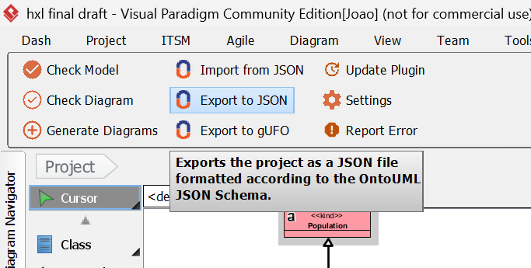
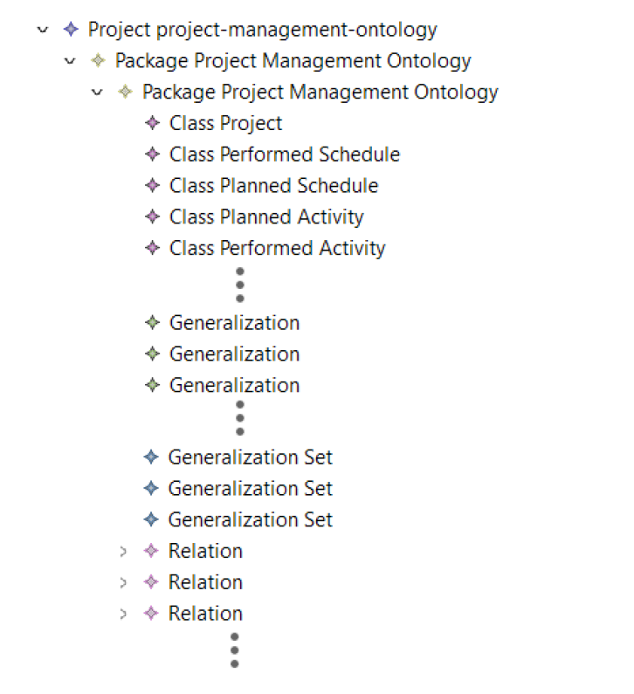
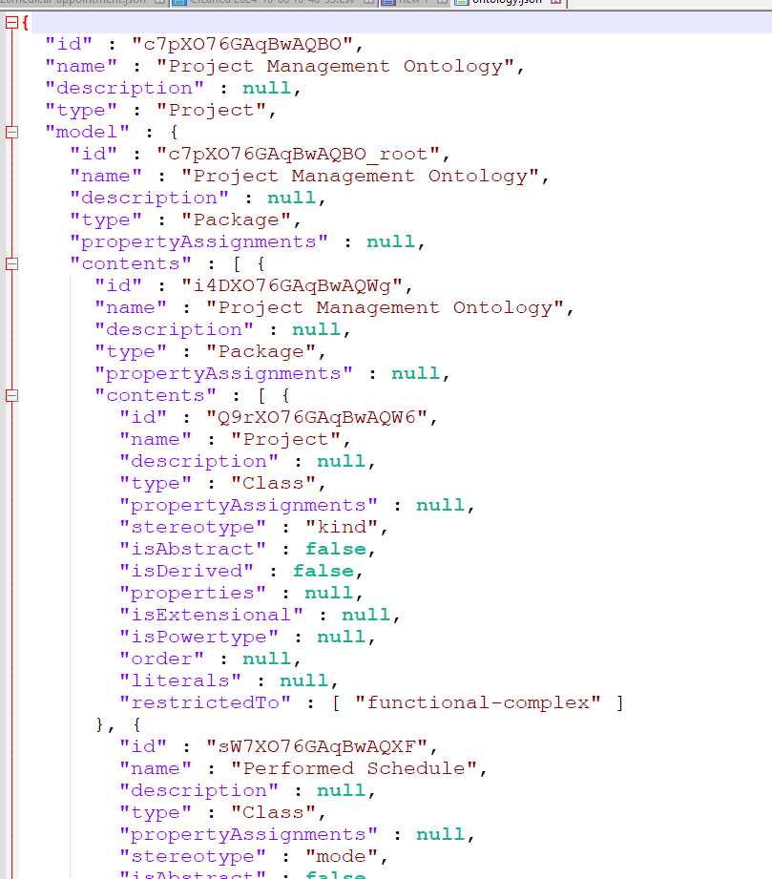
ontouml json reader
EMF Jackson
OntoUML JSON Reader.java
Notes:
Problem

Slide 12
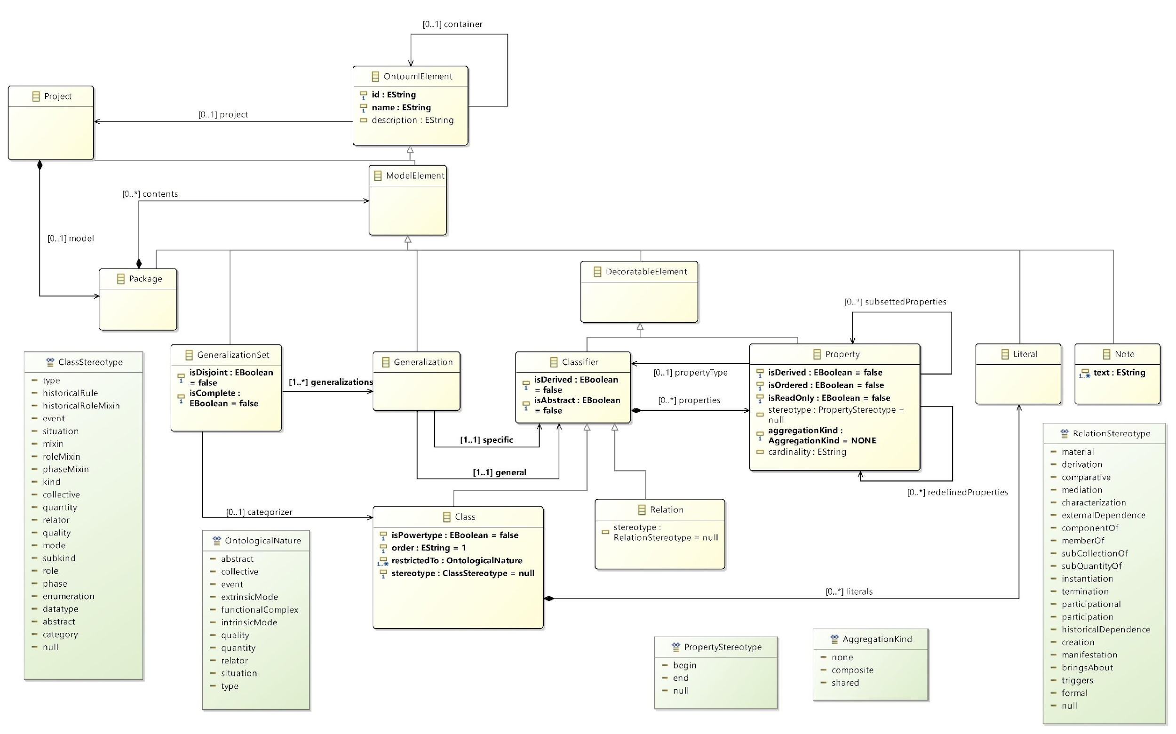
ecore metamodel
OntoUML-specific:
Class, Relation and Ontological Nature
Notes:
OntoUML specific: Class, Relation and Ontological Nature

Slide 13
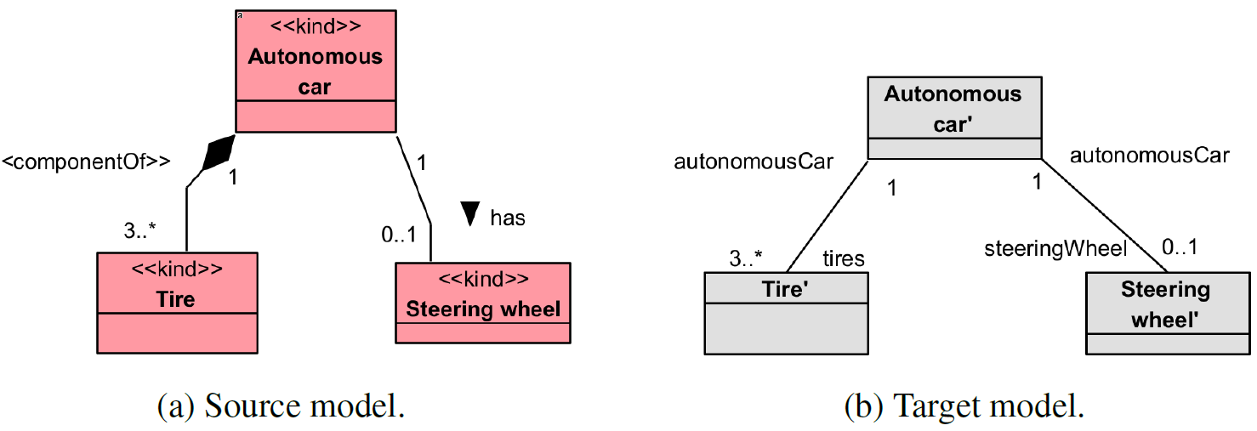
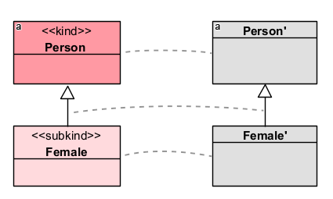
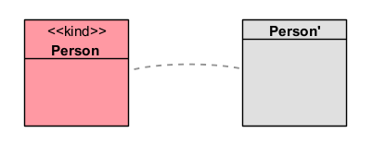
ontouml to uml mappings
Kind & Subkind
(rigid sortals)
Kinds: essential things within a domain, identity provider (functional complex)
Subkinds: specializations of kind that inherit the identity principle
(example)
Notes:
complexes. OntoUML does not enforce the use of specific relation stereotypes
for functional complexes, so we assume this is either done through a plain relation (i.e.,
without stereotype), or a relation marked with componentOf. Figure 3a illustrates this
with a car that has a componentOf relation to Tire and a plain relation to Steering wheel.
Figure 3b illustrates the resulting model. Each kind is transformed into a class
and both relations are transformed into plain associations. We ignored the composition
marker, as from the perspective of the implementation, composition and aggregation relations
are indistinguishable from plain associations [13]. Furthermore, the names of the
association ends are derived from the class names if they are not already present in the
OntoUML model. Multiplicities are preserved.
3.2. Subkinds
Subkinds are rigid sortals that specialize an identity provider. Because of their sortal nature,
they can only have one identity provider as an ancestor, and hence can never specialize
multiple types. This means that we can take over this generalisation in the implementation
model without having to worry about causing multiple inheritance. Figure 4
displays the proposed transformation of subkinds, exemplified with a subkind Female of
a kind Person.

Slide 14
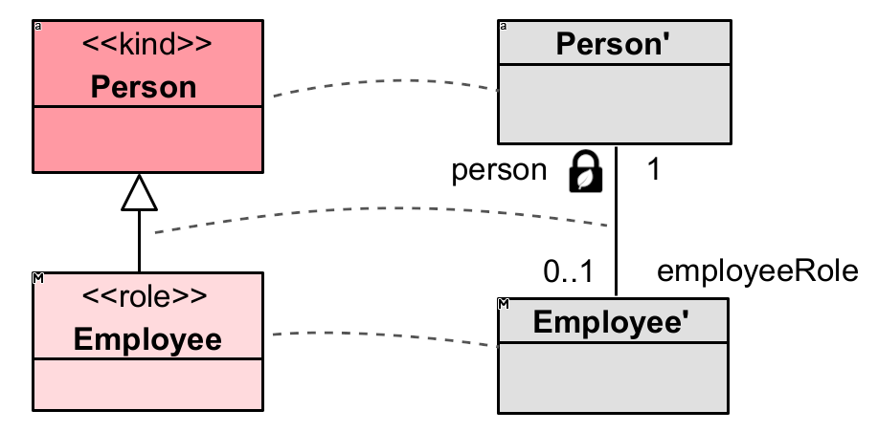
ontouml to uml mappings
Role
(anti-rigid sortals)
In OntoUML, roles are defined using specializations. However, specializations in OO languages are rigid, therefore they are transformed into an association
Obs.1: icon refers to isLeaf (UML) = reference from A to B can never be updated
Obs.2: we refer to these association ends as being marked final (like Java)
Specializes identity providers (e.g., kind), indicating a certain role that something can play at a particular moment in time
Roles can also change over time
Notes:
Obs.: lock/leaf icon refers to isLeaf (UML) = reference (property) from class A to B can never be updated
We refer to these association ends as being marked final (like Java)
Roles are “relationally dependent and anti-rigid substantial universals” [14], meaning
that they are specialisations of identity providers. As roles are anti-rigid, an individual
of a role can cease to instantiate the class while still continuing to exist. This is an issue
in our implementation model as most object-oriented languages specialisations are
rigid [7]. Therefore, a more suitable representation is an association, which can be updated
during the lifetime of an object. The transformation in Figure 5 is similar to the
transformation defined in [7] where the class representing a role in the resulting implementation
model may change. However, the class representing a kind associated with a
role may not change. Figure 5 exemplifies this with the property person of Employee
marked as final.
An alternative considered is the approach from [15] that transforms a role into a
named association to a class originating from a relator. The benefits of this approach are
that it results in fewer classes in the implementation model and it acknowledges that not the role itself, but an OntoUML relator type bears quality properties of a relation [14].
A caveat is that this transformation relies on a relator to be defined in the OntoUML
model. However, one could argue that a role should always have an associated relator
because the roles are relationally dependent. Following this, an individual is an instance
of a role only if it participates in a particular relation [14,8,4], but this is not enforced by
the OntoUML VP plug-in. Furthermore, it is not uncommon to see roles without relators
in the OntoUML model catalogue or literature, e.g., in [8]. We assumed that it is also
desirable to be able to transform these possibly less accurate models.

Slide 15
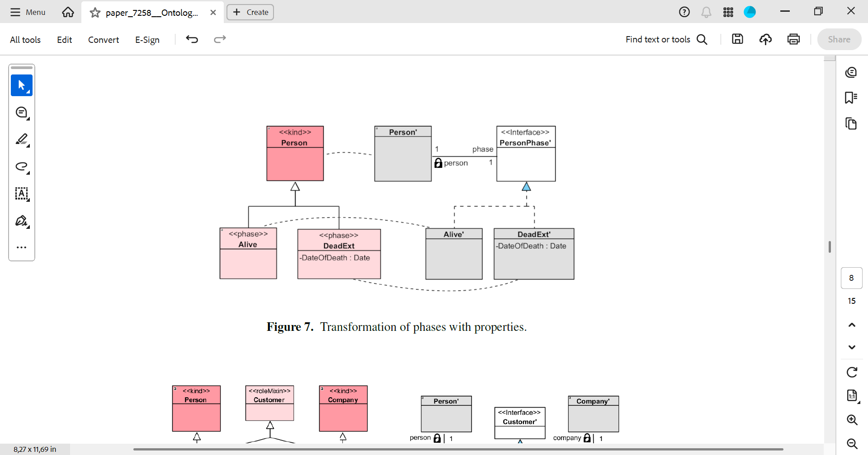
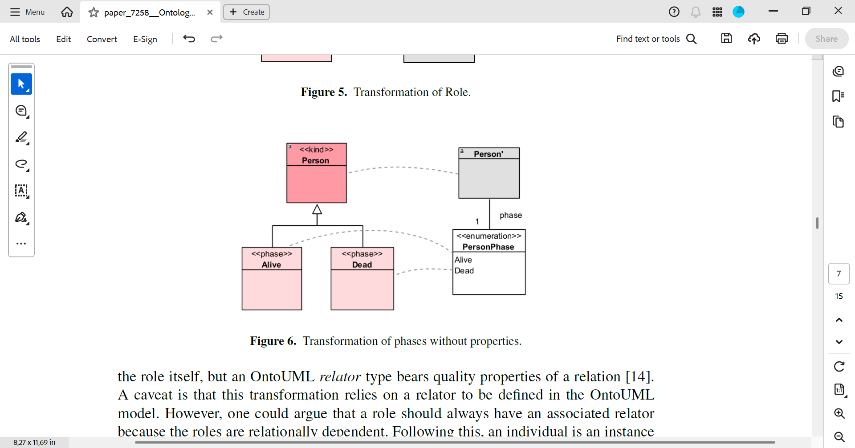
ontouml to uml mappings
Phase: with vs without properties
(anti-rigid sortals)
Without: enum with multiplicity = 1 for completeness and disjointedness
With: interface is generated that is implemented by classes (phases)
Relation (class – interface) ➔ UML Interface realization
Resembles the state design pattern (state changes)
Notes:
Phases are grouped in a generalisation set that is complete and disjoint. Considering
the example in Figure 6, a person is always in one state (a phase), which is either
alive or dead. OntoUML itself does not include restrictions on the transitions between
phases, so in this example, it would be allowed for a person to transition from the dead
to the alive phase.
For phases without properties,
only the knowledge of what phase a certain kind is in seems relevant, which is
represented by an enumeration with a multiplicity of exactly one, covering completeness
and disjointedness. The names for the enumeration literals are taken from the names of
the phase classes.
In contrast, the property of a phase, like DateOfDeath for the Dead phase in Figure 7,
cannot be represented in an enumeration, so an interface is generated that is implemented by classes, each representing one phase. The class representing the Person kind in this
case then has an association with multiplicity one to the PersonPhase interface, and
each class that represents a phase has its respective properties. In the implementation
model, the relation between the class and interface is a UML Interface realisation. The
construct in Figure 7 resembles the state design pattern,6 which indeed is a best practice
to implement state changes. In addition, the associated person property of each phase is
marked as isLeaf, which (as we have seen) will later generate a final attribute in the Java
code.

Slide 16
ontouml to uml mappings
Summary
In this paper: kind/subkind, role, phase, roleMixin, relator
In the thesis [10]: 12 OntoUML stereotypes
Selection based on frequency in the OntoUML catalogue (most popular)
Extension of previous works [7, 17]
Wider selection of OntoUML stereotypes
Different design decisions for transformation of some constructs
Considerations in the UFO/OntoUML semantics
Pragmatic effects when generating Java code
[7] Pergl R, Sales TP, Rybola Z. Towards OntoUML for software engineering: from domain ontology to implementation model. In: Model and Data Engineering: Third International Conference, MEDI 2013
[10] https://purl.utwente.nl/essays/104610
[17] Carraretto R, Almeida JPA. Separating Ontological and Informational Concerns: Towards a Two-Level Model-Driven Approach. In: 2012 IEEE 16th International Enterprise Distributed Object Computing
Conference Workshops; 2012. p. 29-37.

Slide 17
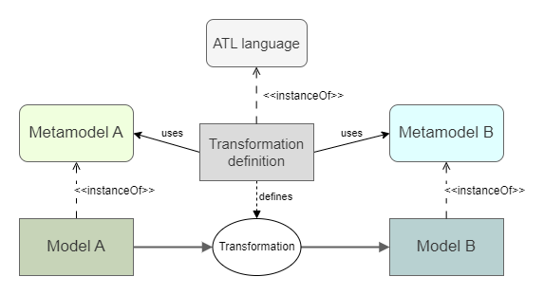
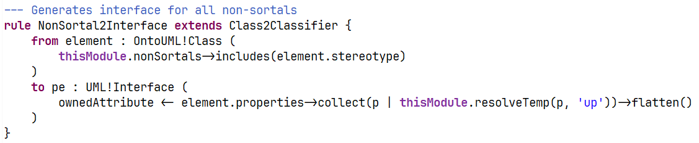
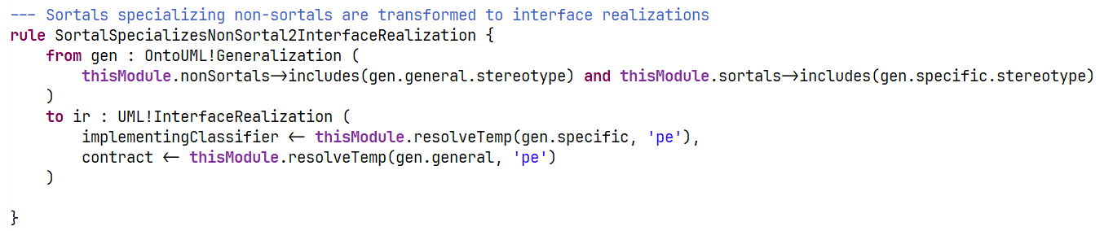
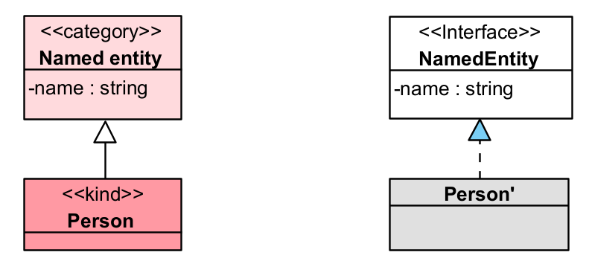
atl transformations
(some ATL rules)
ATL
Notes:
Implemented with the Atlas Transformation Language
Rule-based model-to-model transformations in EMF

Slide 18
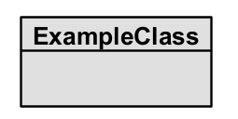
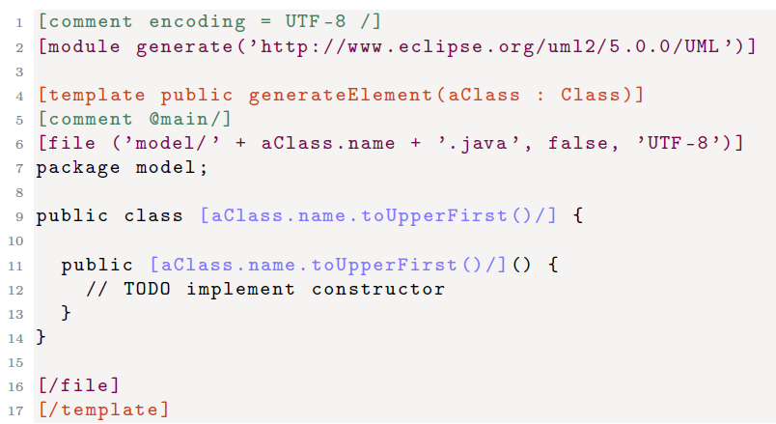
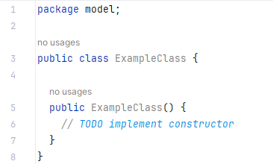
Java code generation
Acceleo
Acceleo: template-based model-to-text transformations in EMF
Reused an existing UML-to-Java project (updated and bugs fixed)
https://github.com/ObeoNetwork/UML-Java-Generation
Notes:
Implemented with Acceleo
Template-based model-to-text transformations in EMF
Reused an existing UML-to-Java project
Updated and bugs fixed

Slide 19
Model-Driven Software Engineering (MDE)
Research approach
MDE Transformation pipeline
Validation
Conclusions
Notes:
1. Model-Drive Software Engineering
OntoUML
Ontology-Driven Software
2. Research approach
3. Transformation pipeline
Ecore metamodel
OntoUML JSON reader
OntoUML to UML mappings
Transformations 1: OntoUML to UML
Transformations 2: Java code generation
4. Validation
5. Conclusion

Slide 20
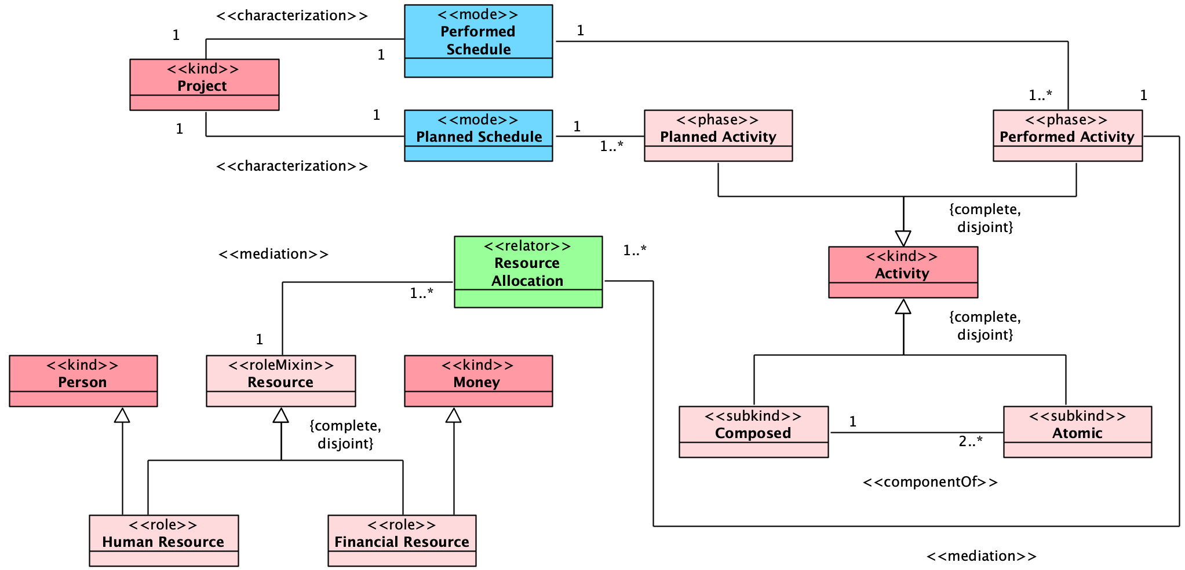
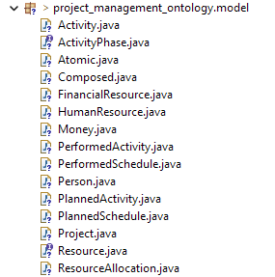
Validation 1: transformation example
Project Management ontology (from OntoUML catalog)
- Various OntoUML stereotypes (covered by our mappings)
- Neither too small nor too large for illustration
Notes:
Full transformation example: Project Management ontology
Transformation of OntoUML models from the catalogue
Manual validation
=============================
Various OntoUML stereotypes (covered by our mappings)
Neither too small nor too large for illustration.

Slide 21
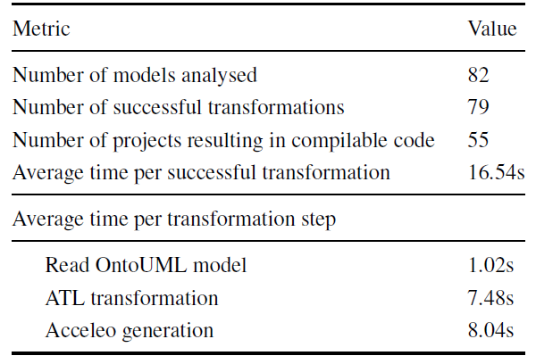
Validation 2: 82 models from catalogue
3 models failed during the OntoUML model reading: invalid stereotypes
4 categories of compile errors: duplicate variable definition (16), reserved keyword used as name (4), multiple class inheritance (2), invalid override from superclass (2)
All issues of the models!
Successful compilation does not ensure correctness but indicates a valid model
Complete correctness would require manual verification (OntoUML model) to ensure correspondence (miss expected elements but can still be compiled)
Notes:
A Python script was created to execute ANT tasks related to the transformation process.
An additional ANT task was defined to compile the generated Java code using Java SE 21 (latest LTS version).
For each model analyzed, data was collected on transformation steps, including:
Execution time of each step.
Warnings produced by ATL and Acceleo transformations.
Step of failure and corresponding error logs, if the process failed.
After transformation, an ANT build task was executed on the generated code to check whether it could be compiled; failure logs were recorded if compilation failed.
Successful compilation does not ensure correctness of transformation but indicates that a valid implementation model was generated.
Complete correctness would require manual verification against the OntoUML model to ensure correspondence with expected implementation constructs.
The validation process was applied to 82 OntoUML models containing only class stereotypes supported by the transformation.
Processing environment specifications were documented separately.

Slide 22
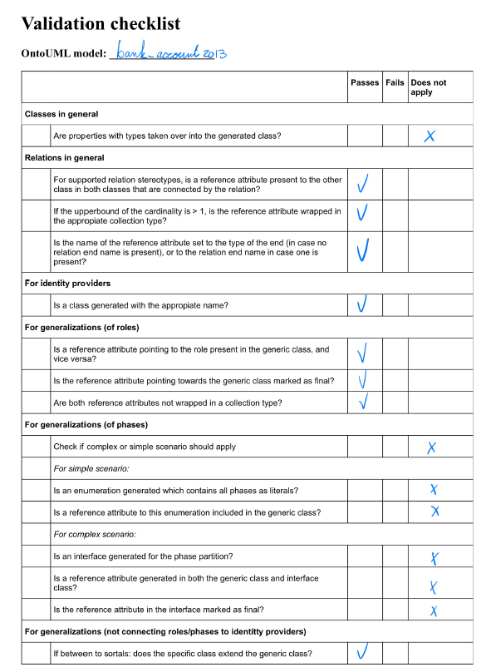
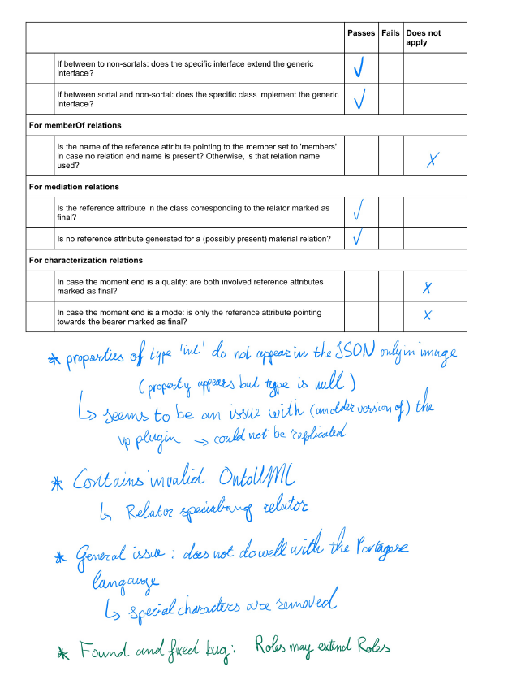
Validation 3: java code inspection
Manual validation on 5 OntoUML models (catalog)
yield compilable code
alphabetical order
3 models with OntoUML syntactic validation issues
Subkinds that do not specialize any identity provider
Relators that specialize other relators
Obs.: Results lead to minor improvements in the transformation pipeline
Notes:
Correctness confidence: manual validation on 5 OntoUML models from the catalogue (yield compilable code, alphabetical order)
Checklist for generation patterns
Generate code
Manually check results
Invalid OntoUML constructs: 3 models would be marked as invalid by VP plugin (e.g., subkinds that do not specialize any identity provider, relators that specialize other relators
Results lead to minor improvements in the transformation pipeline

Slide 23
Model-Driven Software Engineering (MDE)
Research approach
MDE Transformation pipeline
Validation
Conclusions
Notes:
1. Model-Drive Software Engineering
OntoUML
Ontology-Driven Software
2. Research approach
3. Transformation pipeline
Ecore metamodel
OntoUML JSON reader
OntoUML to UML mappings
Transformations 1: OntoUML to UML
Transformations 2: Java code generation
4. Validation
5. Conclusion

Slide 24


conclusions
Key contributions and lessons learned
Frequency analysis of OntoUML stereotypes in the model catalogue
Ecore metamodel aligned with OntoUML VP plugin (JSON export)
Comprehensive OntoUML-to-UML transformation (implemented in ATL)
Model-to-text transformation enabling Java code generation
Strategies and tooling for automated and manual validation of OntoUML models
Code analysis and repository of the generated code of models from the catalogue
Research oriented to reproducibility and reuse
Limitations
Focus only on Java class generation, no support for behavioral aspects or persistence
Lack of real-world application validation and developer comparison (user study)
Future work
Extend to cover operations & persistence (e.g., Hibernate, databases, triplestores)
Validate transformation in realistic software development scenarios
Empirical studies on whether OntoUML leads to higher-quality applications
Explore new transformations inspired by gUFO design principles
Notes:
Contributions
EMF Ecore metamodel for OntoUML
Transformation defined for 12 OntoUML class stereotypes
Implemented transformation in ATL
UML-to-Java code generation
Automated validation on models from the catalogue
Insights about the implementation of OntoUML
Code repository of the generated code from the OntoUML models (catalogue)
Code analysis of the available models from the catalogue
Focus on research reproducibility and reuse
Possible improvements:
Alignment of OntoUML tools
Improved validation
Generating code for other programming languages
Future work
Does OntoUML and this transformation improve the code quality when used in practice?
Longitudinal case study comparing plain UML with OntoUML

Slide 25
discussion
Alignment of OntoUML Tools
Discrepancies between VP plugin JSON and OntoUML schema/metamodel
Transformation may require adjustments if tooling evolves
Validation Limitations
Current testing mostly manual + partial automation
Lack of automated test cases for transformation correctness
Extending Code Generation
Current focus on Java, but approach supports other OO languages
Options: reuse/extend Papyrus or Acceleo projects
Alternative Implementation Model
Explore UML Profile-based implementation models (limited ATL support)
Potential to enrich semantics (e.g., constructors, persistence metadata).
Data Persistence
Requires strategies to align generated code with DBMS (incl. NoSQL)
Notes:
Alignment of OntoUML Tools
Discrepancies between VP plugin JSON and OntoUML schema/metamodel.
Need for a single source of truth for OntoUML metamodel.
Transformation may require adjustments if tooling evolves.
Validation Limitations
Current testing mostly manual + partial automation.
Lack of automated test cases for transformation correctness.
Defining automated validation methods could benefit ATL broadly.
Extending Code Generation
Current focus on Java, but approach supports other OO languages.
Options: reuse/extend Papyrus or Acceleo projects.
Challenges with language-specific features (naming, typing, inheritance).
Alternative Implementation Model
Explore UML Profile-based implementation models.
Potential to enrich semantics (e.g., constructors, persistence metadata).
Limited ATL support for UML profiles poses challenges.
Data Persistence
Current code lacks persistence support.
Options: OntoUML-to-relational schema generation or Jakarta persistence.
Requires strategies to align generated code with database schemas.

Slide 26
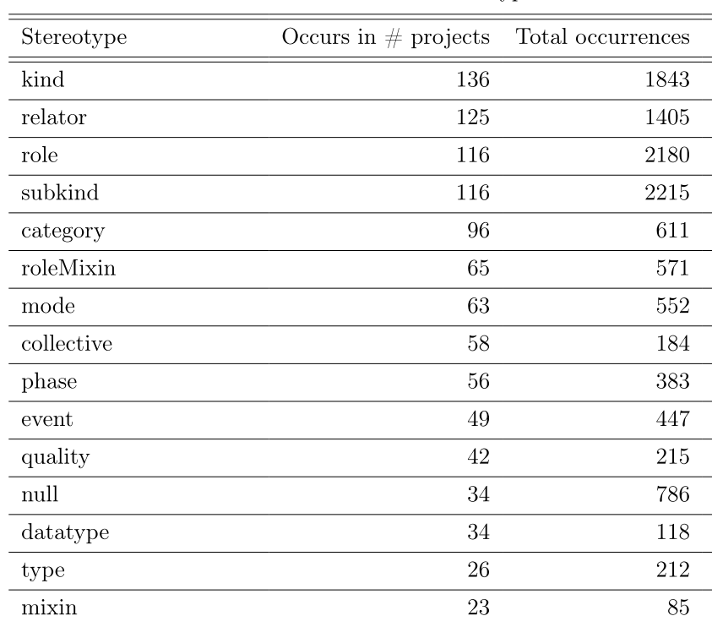
Reuse in Ontology Engineering
Considerable research on how to reuse existing ontologies… But still represents a significant challenge - especially in practice!
Possible reasons
a) Often domain-specific, and developed for a specific purpose in a particular context
Reuse in another domain: extensive modifications - inefficient and time consuming
b) Contextual, created by different individuals varying points of view and design practices
Inconsistencies (e.g., Building in IFC), only basic class equivalence alignments
c) Evolving technologies and changing requirements, requiring continuous modifications
Ontology management and governance issues (e.g., IFC ontology versions)
d) Specific cases: ontologies cover information that are sensitive to companies
Developed internally, e.g., for improved control and security
Moreira, J. L. R., Donkers, A. J., Pauwels, P., Bektas, E., & van Ee, T. (2024). Onto4Reuse: Towards an ontology reuse framework for knowledge-intensive software engineering. In Proceedings of the Joint Ontology Workshops (JOWO)-Episode X: The Tukker Zomer of Ontology, and satellite events co-located with the 14th International Conference on Formal Ontology in Information Systems (FOIS 2024). CEUR-WS. org.
Notes:
One key first step is applying an ontology. This involves the use of an existing ontology within a specific context or application, typically to provide structure and semantic meaning to data or knowledge within that context. This is strongly supported and advocated in many domains, including the construction industry, through the use of a standard ontology, such as the Industry Foundation Classes (IFC), for data exchange processes.
It is strongly recommended to rely on existing ontologies and apply them to future cases [11].
in a large majority of cases, the ontology that is meant to be applied does not fully match the considered case, and an extension, modification, or just a subset is needed. In such case, a number of
approaches can be followed: 1) the software engineer moves away from OR and starts developing an entirely new ontology (the ”11th standard”); 2) the software engineer makes minor local changes to the ontology, and potentially notifies the creator of
the original ontology; and 3) the software engineer combines the ontology with one or more other ontologies that make up for missing or to be modified parts, such as in [9].
This can be recognized in efforts where a standard ontology is adopted, e.g. IFC, yet extended with a
few more specific properties or classes for object representation. Reusing an ontology entails
adopting an existing ontology in the development of new systems, often involving integration
with other ontologies or customization to fit the requirements of the new context, while striving
to maintain compatibility and interoperability with the original ontology. Such an example can
be found in the attempt to reuse the IFC ontology in the creation of the SAREF4BLDG ontology2,
where a subset of classes and properties were kept, while referring to the source ontology.
Considerable research has been done on how to reuse existing ontologies [5, 6, 13, 7] - still represents a significant challenge (practice).
1) Ontologies are often domain-specific, and developed with a specific purpose to capture knowledge within a particular context or industry [3]. Reuse in another domain requires (extensive) modifications, often rendering the reuse effort inefficient and time consuming
2) Semantics are contextual and ontologies are typically created by different individuals or groups with varying points of view to fit specific purposes along with different design principles and methodologies, leading to disparities in structure, naming conventions, and modeling choices [7]. Examples: Building in the BOT, SAREF, IFC, and BRICK ontologies [14]: inconsistencies make- At best, only basic class equivalence alignments can be made, which represent often less than 10% of the ontology scope.
3) evolving technologies and changing domain-specific requirements can quickly render existing ontologies obsolete, requiring continuous updates and modifications, further complicating ontology management and governance (see for example the IFC ontology versions).
4) In some specific cases, ontologies cover information that are sensitive to companies and, therefore, are developed internally, e.g., for improved control and security, which impacts OR.

Slide 27
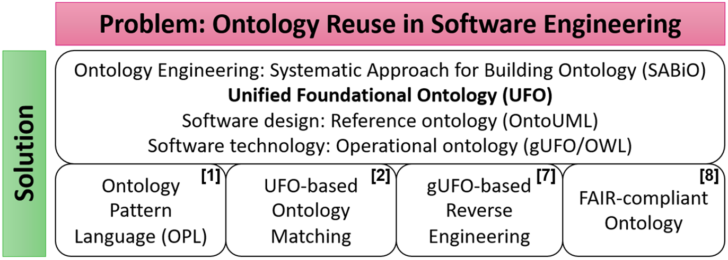
Onto4reuse: The four pillars
[1] FALBO, R. D. E. A., BARCELLOS, M. P., RUY, F., GUIZZARDI, G., & GUIZZARDI, R. S. S. (2016). Ontology pattern languages. Ontology Engineering with Ontology Design Patterns, 1(August), 133–159.
[2] Foundational Ontologies meet Ontology Matching : A Survey. Semantic Web, 0(0). Trojahn, Cassiaa | Vieira, Renatab | Schmidt, Danielac | Pease, Adamd | Guizzardi, Giancarlo http://kyoto-project.eu/xmlgroup.iit.cnr.it/kyoto/index.html
[7] Paulo Favato Barcelos, P., Romanenko, E., & Paulo Almeida, J. A. (2023). Inferring Ontological Categories of OWL Classes Using Foundational Rules. FOIS 2023.
[8] R. Çelebi, J. L. R. Moreira, A. A. Hassan, S. Ayyar, L. Ridder, T. Kuhn, M. Dumontier, Towards fair protocols and workflows: the openpredict use case, PeerJ Computer Science 6 (2020).
[9] Tiago Prince Sales et al. (2023). A FAIR catalog of ontology-driven conceptual models. Journal Data & Knowledge Engineering. https://doi.org/10.1016/j.datak.2023.102210
Notes:
how to embed existing ontologies in the development of knowledge-intensive software systems through ontology engineering good practices on ontology reuse?

Slide 28
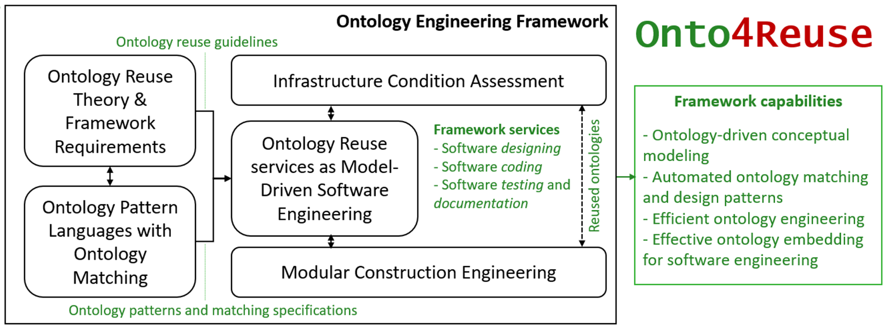
Onto4reuse framework
Notes:
how to embed existing ontologies in the development of knowledge-intensive software systems through ontology engineering good practices on ontology reuse?

Slide 29
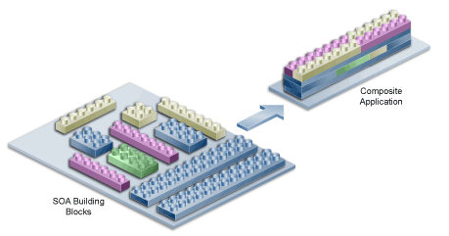
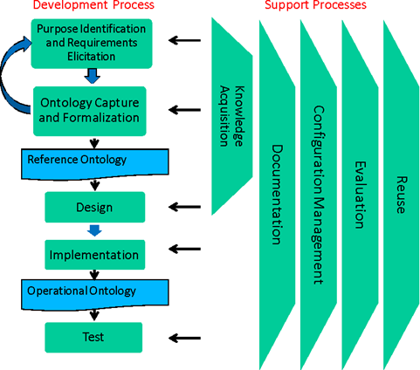
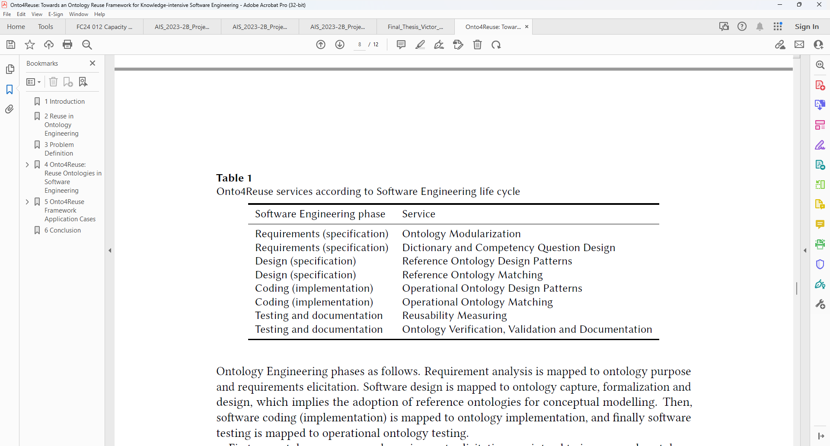
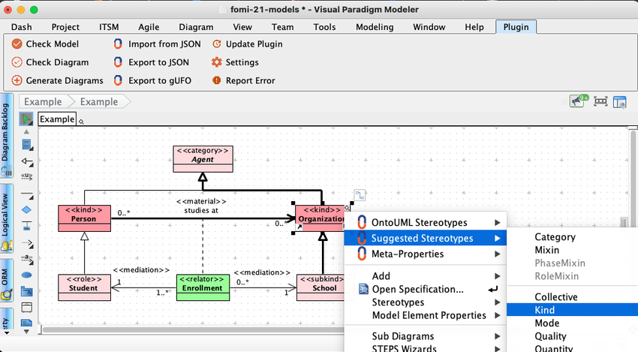
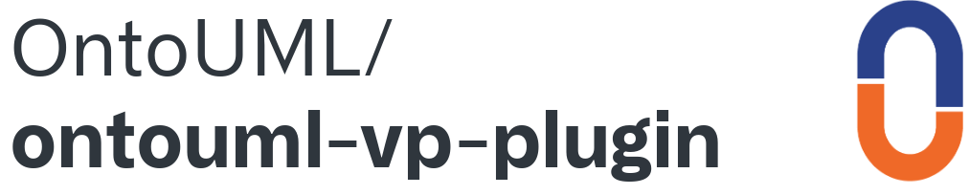
Onto4reuse services
SABiO: Systematic Approach for Building Ontologies
Notes:
how to embed existing ontologies in the development of knowledge-intensive software systems through ontology engineering good practices on ontology reuse?
SABiO: Systematic Approach for Building Ontologies

Slide 30
Ontologies for international data spaces
The Soberana Ontology: Modeling Business Ecosystems for International Data Spaces. TO BE PUBLISHED. In Formal Ontology in Information Systems (FOIS 2025). IOS Press.
> BSc thesis (Manoel UFERSA) + PhD research (Glenda Amaral)

Slide 31
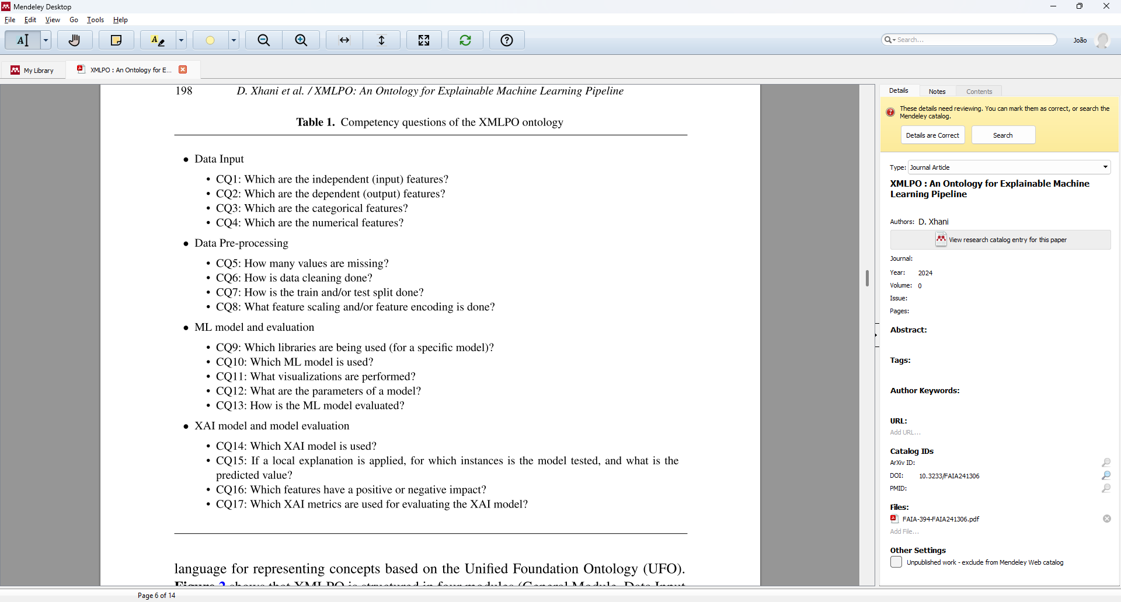
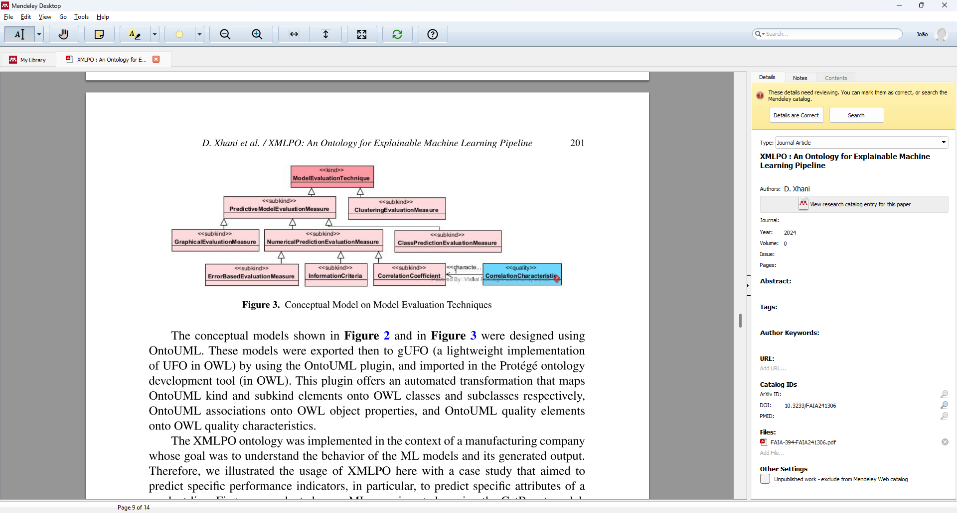
Ontology-driven explainable ai
Xhani, D., Rebelo Moreira, J. L., van Sinderen, M., & Ferreira Pires, L. (2024). XMLPO: An Ontology for Explainable Machine Learning Pipeline. In Formal Ontology in Information Systems (pp. 193-206). IOS Press.
> EngD thesis (Donika) under embargo 5y + MSc thesis (Patricia): https://essay.utwente.nl/87394/

Slide 32
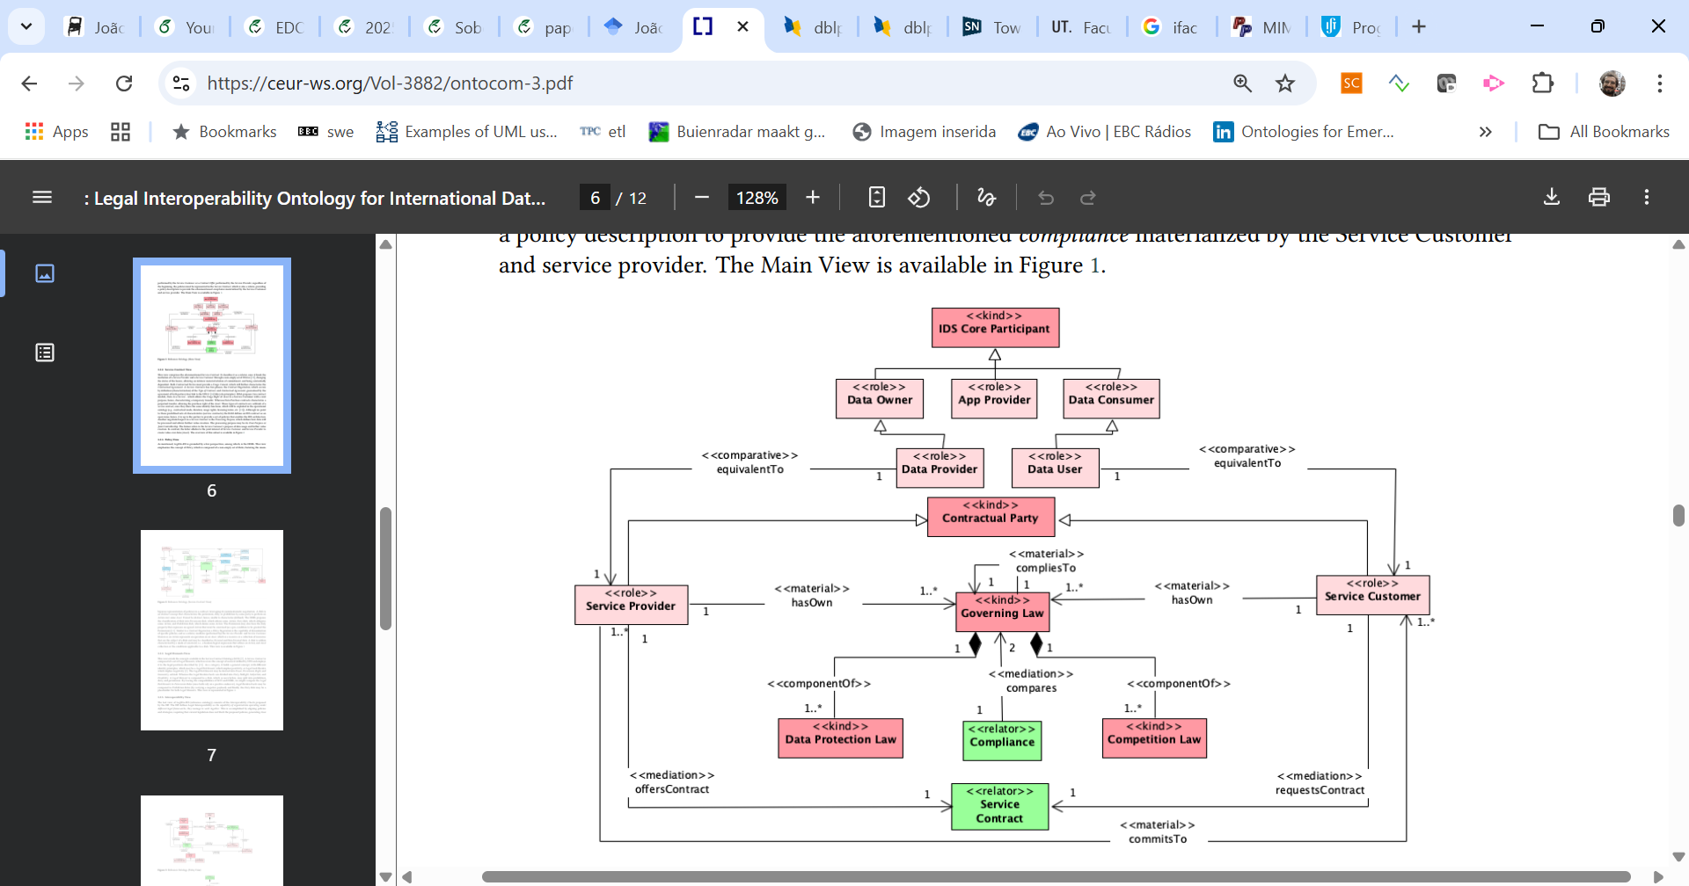
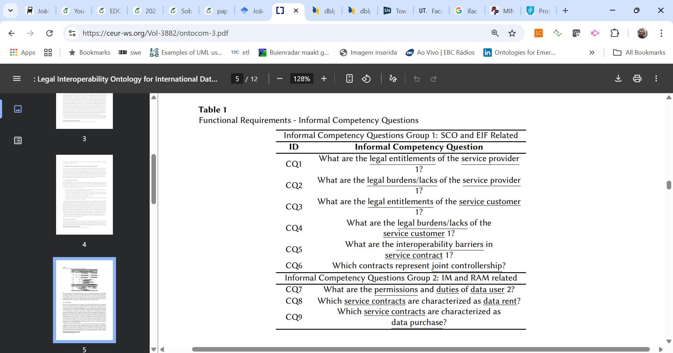
Ontologies for international data spaces
- Oliveira, V., Silva, P. and Luiz Rebelo Moreira, J. (2024). Towards Legal Interoperability in International Data Spaces. In Proceedings of the 26th International Conference on Enterprise Information Systems - Volume 2: ICEIS; ISBN 978-989-758-692-7; ISSN 2184-4992, SciTePress, pages 232-239. DOI: 10.5220/0012699600003690
- Oliveira, V., Silva, P., & Moreira, J. (2024). LegIOn-IDS: Legal Interoperability Ontology for International Data Spaces. In Proceedings of the Joint Ontology Workshops (JOWO)-Episode X: The Tukker Zomer of Ontology, and satellite events co-located with the 14th International Conference on Formal Ontology in Information Systems (FOIS 2024). CEUR-WS. org.

Slide 33
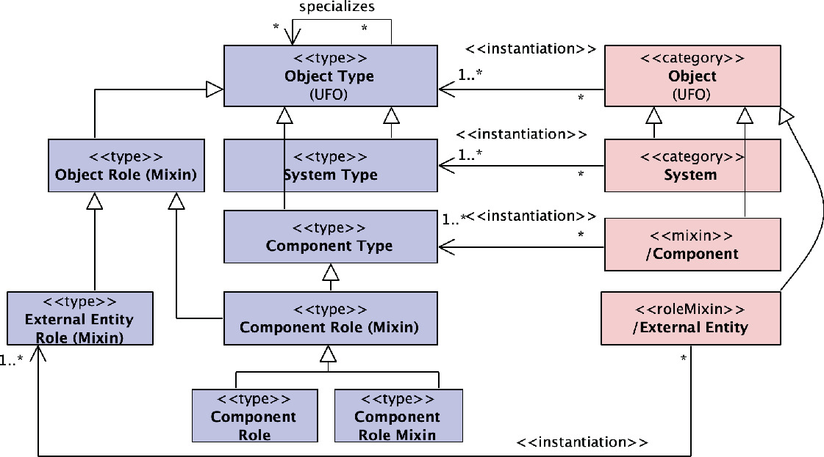
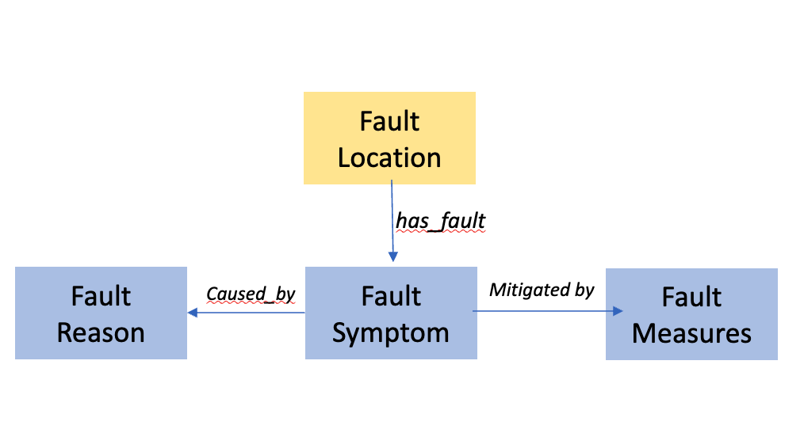
Ontology-driven system modeling
- Calhau, R.F. et al. (2025). Towards an Ontology of Type-Level Phenomena for System Modeling. In: Grabis, J., Vos, T.E.J., Escalona, M.J., Pastor, O. (eds) Research Challenges in Information Science. RCIS 2025. Lecture Notes in Business Information Processing, vol 547. Springer, Cham. https://doi.org/10.1007/978-3-031-92474-3_8
- MSc thesis: Smarter Industrial Fault Diagnosiswith Knowledge Graphs andLarge Language ModelsA Case Study at Mintres BV. Wan Barmawi Muhammad Razaq (TO BE SUBMITTED)
Notes:
Connection to Wan’s thesis
[ontology engineering]

